Slide 1
‘Stepping back from stepping in’
Bite Sized Professional Development
Why and What of Reablement
Powered by

Slide 2
Session objectives
Participants of this session will:
Enhance their understanding of the ageing process
Increase their understanding of why supporting clients to participate in activities will maximise their independence
Understand how reablement assists clients to achieve their goal/s
Enhance an understanding of the role they play in assisting clients to achieve their goals

Slide 3
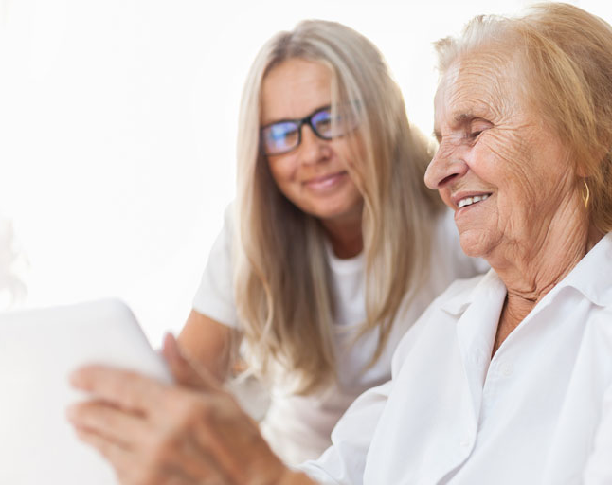
Rethinking Ageing
Biological changes as we age - consequence of buildup of cellular damage and its impact over time
Different for every individual and only loosely connected with a person's age
Little to do with genetics only 25%
75 % related to healthy behaviours - eating balanced diet, regular physical activity, fostering relationships can enable people to continue to do what is important to them
No matter what age - there are benefits to be gained from practicing healthy behaviours

Slide 4
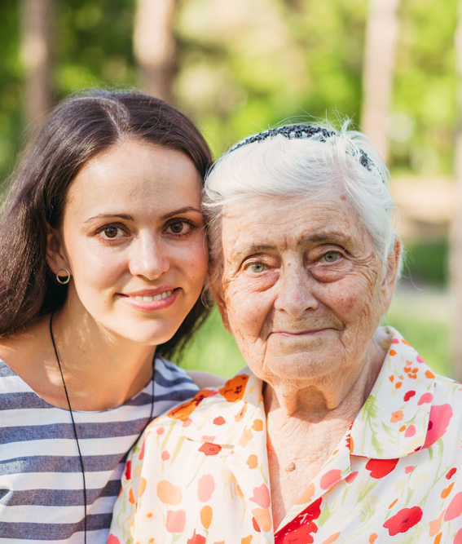
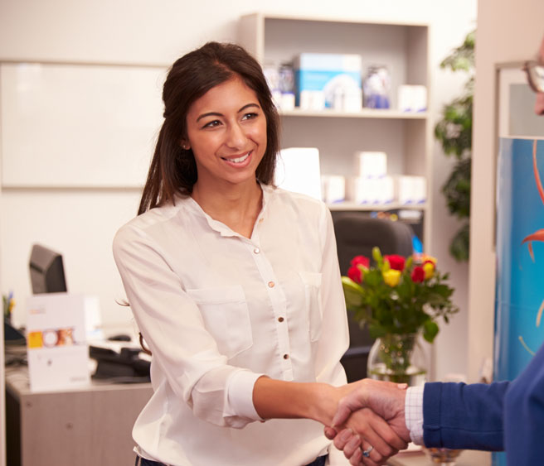
Small group discussion
How do you currently support clients to practice healthy behaviours?

Slide 5
What is wellness and reablement?
Wellness approach
Recognises client abilities and need to regain or retain;
Recognises that service support needs to enable the person and provide opportunities to build capacity-focus on achieving outcomes;​
Service support provided for those activities that the individual cannot do without assistance
Support ‘to do’ or ‘do with’​
Regular review is built into the support/care plan
Reablement
Reablement is a short-term or time limited intervention that is more targeted towards a person's specific goal or desired outcome to changed circumstances such as functional loss, or to regain confidence and capacity to resume activities.​
​
Supports could include:​
Training in a new skill or actively working to regain or maintain an existing skill
Modification to a person's home environment
Using equipment or assistive technology to complete a task​

Slide 6
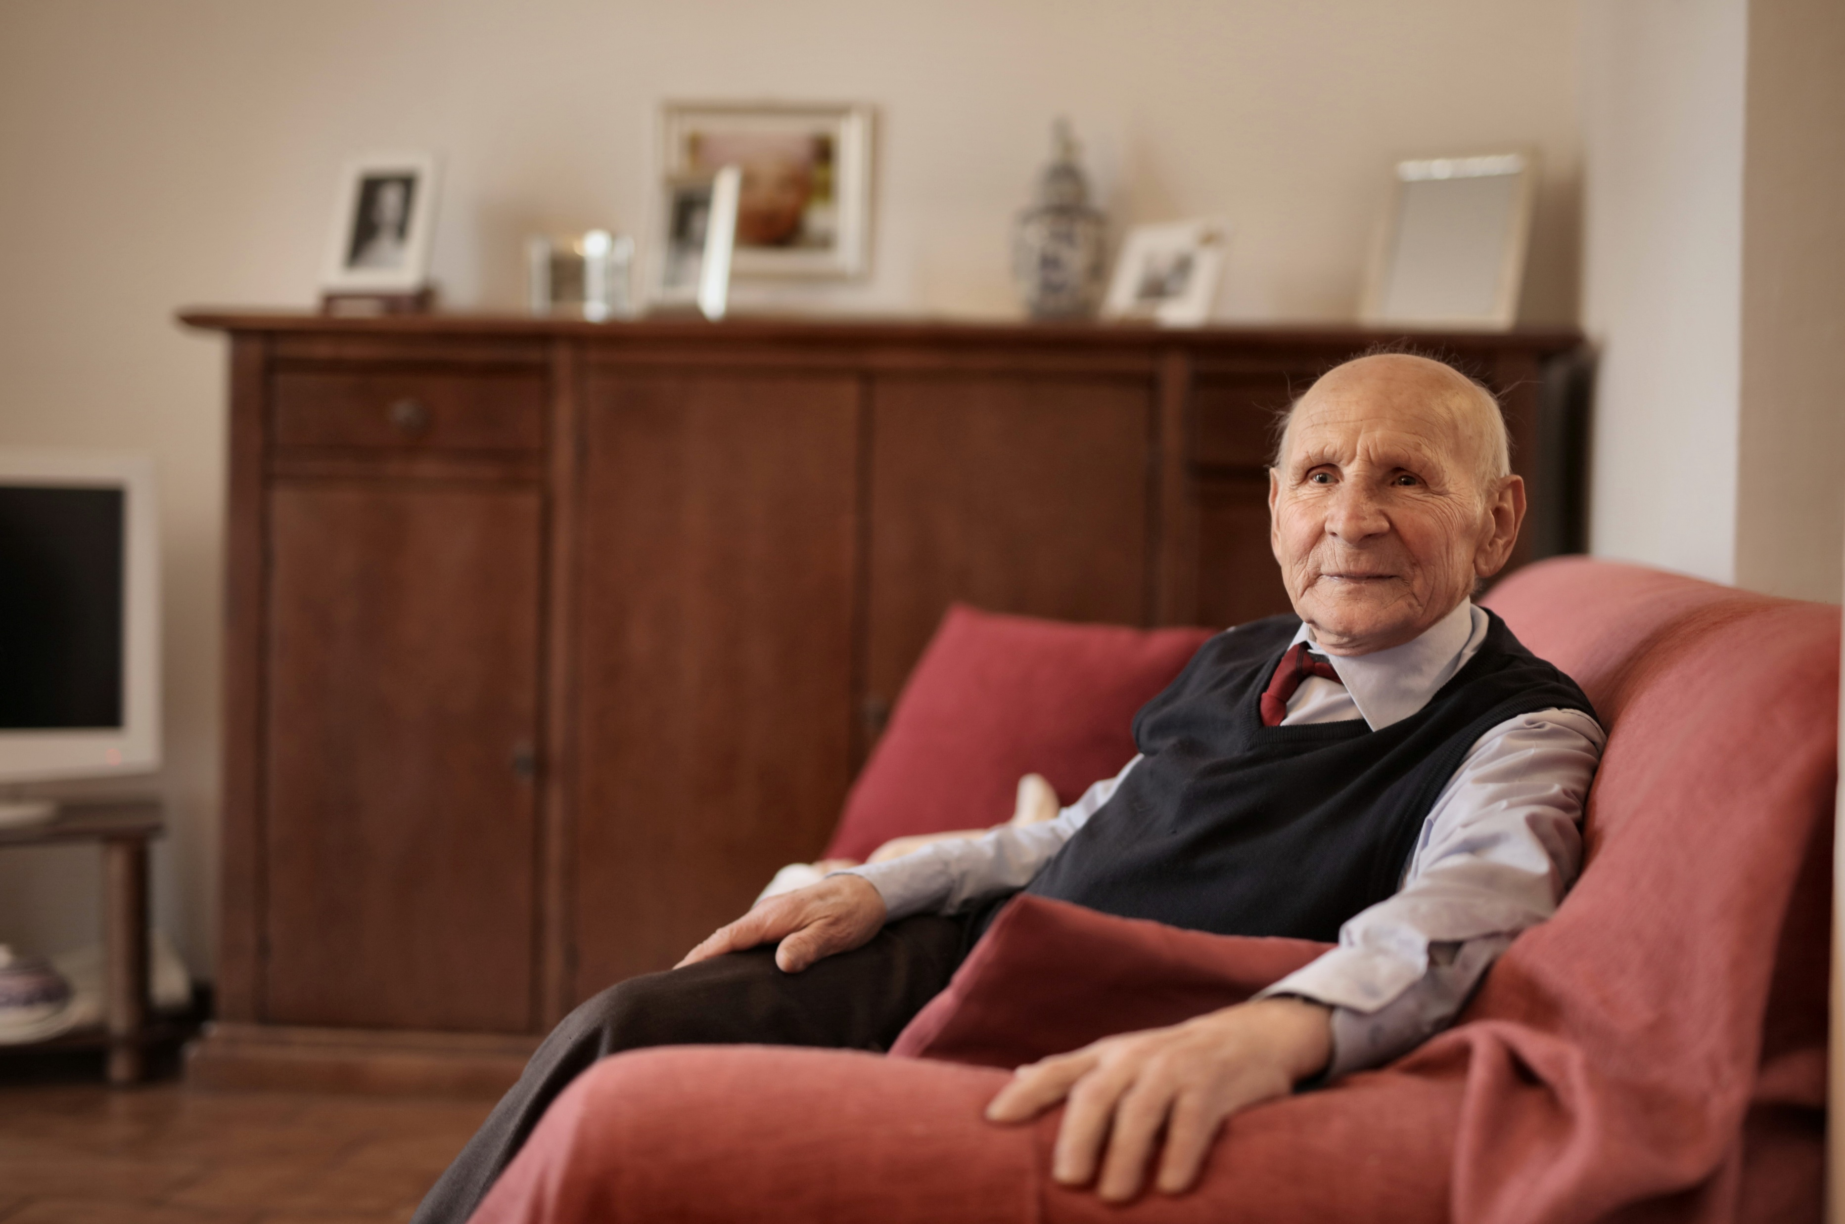
Every opportunity matters on an individual level
Jack requires support with showering and household tasks after a fall. He is in pain and lost confidence to shower independently.
Staff encourage Jack to sit and wait and not take any risks in case he has another fall - after all, that is why they are there supporting him.
Meet Jack. He has had a fall in his back yard injuring his shoulder and leg. After a brief stay in hospital, he was discharged home and support for personal care and domestic assistance was commenced.
Jack stops using his sore arm altogether in the hope the pain will go away and waits for support staff to come before he has a shower or attempts to do any tasks around the house.
Due to Jack’s pain and lack of confidence support staff step in and complete all Jack’s personal care and domestic tasks.
As the weeks go by Jack’s pain lessens, but due to him not using his arm at all, the muscles and tendons lose any strength, and his arm weakens. Jacks’ confidence in his abilities to get back to where he was lessens. Ongoing support is established for Jack.
Notes:
Dependency model-

Slide 7
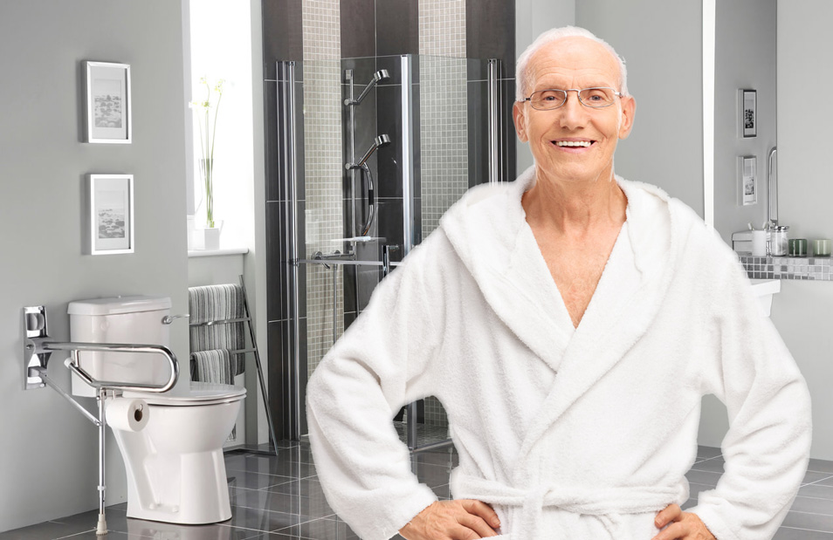
Every opportunity matters on an individual level
Jack requires support with showering and household tasks after a fall. He is in pain and lost confidence to shower independently.
Tasks are broken down into small steps. With encouragement Jack is able to complete some of his personal care tasks except those that require reaching above his head. Due to Jack continuing to do what he can he regains some confidence and strength through continuing to complete these tasks.
Meet Jack. He has had a fall in his back yard injuring his shoulder and leg. After a brief stay in hospital, he was discharged home and support for personal care and domestic assistance was commenced.
Jack's capacity to shower independently and self belief increases which has a positive impact on his willingness to try other tasks such as hanging his washing on a clothes airer.
Over the weeks Jack is able to complete his personal care tasks on his own. His increased confidence and movement has enabled him to work on managing all his domestic tasks independently once again.
Jack is happy for his services to be withdrawn and knows he can receive services again if he has the need.

Slide 8
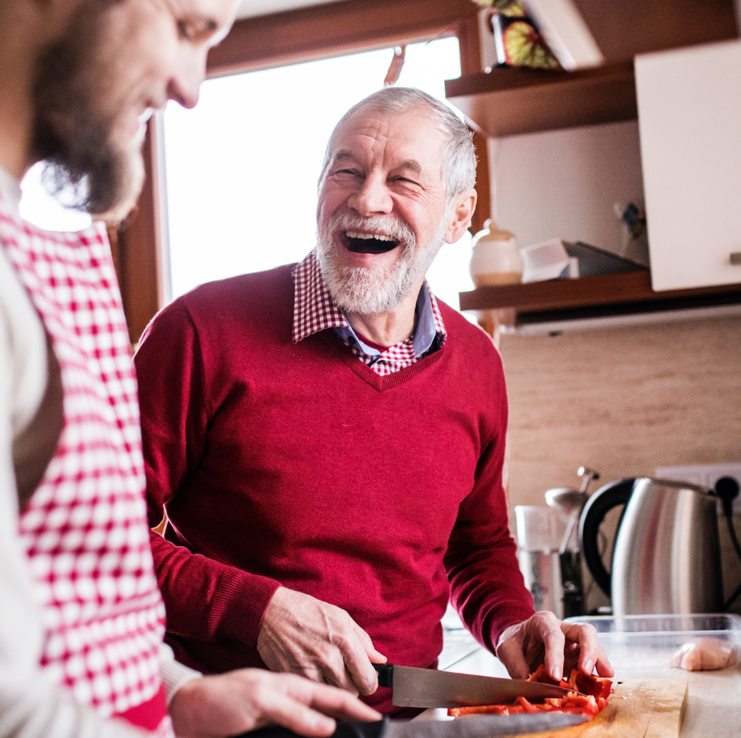
What role do you play?
Small group activity –
Case scenarios
Read through the scenarios
In your group, discuss how in your role you would assist this client to remain independent in the activities they are finding difficult.
Share with the larger group

Slide 9
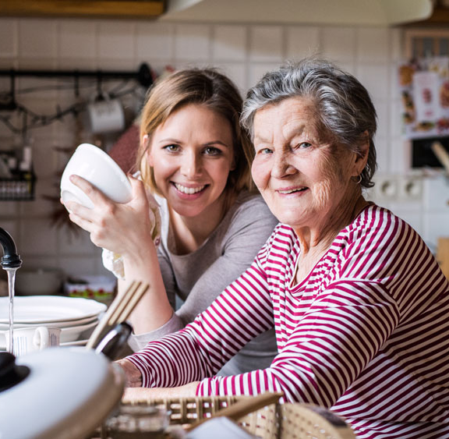
Any questions?
Evaluation
Thank you

