Slide 1
‘Stepping back from stepping in’
Bite Sized Professional Development
Working with clients and low risk assistive technology

Slide 2
Session objectives
Participants in this session will:
Increase their understanding of what Assistive Technology (AT) is and how it supports people to increase their independence
Be able to identify what Assistive Technology is and when it should be used
Increase confidence in using low risk Assistive Technology with clients
Enhance awareness of when to refer to Allied Health
Enhance awareness of pathways/resources that can assist people to access AT

Slide 3
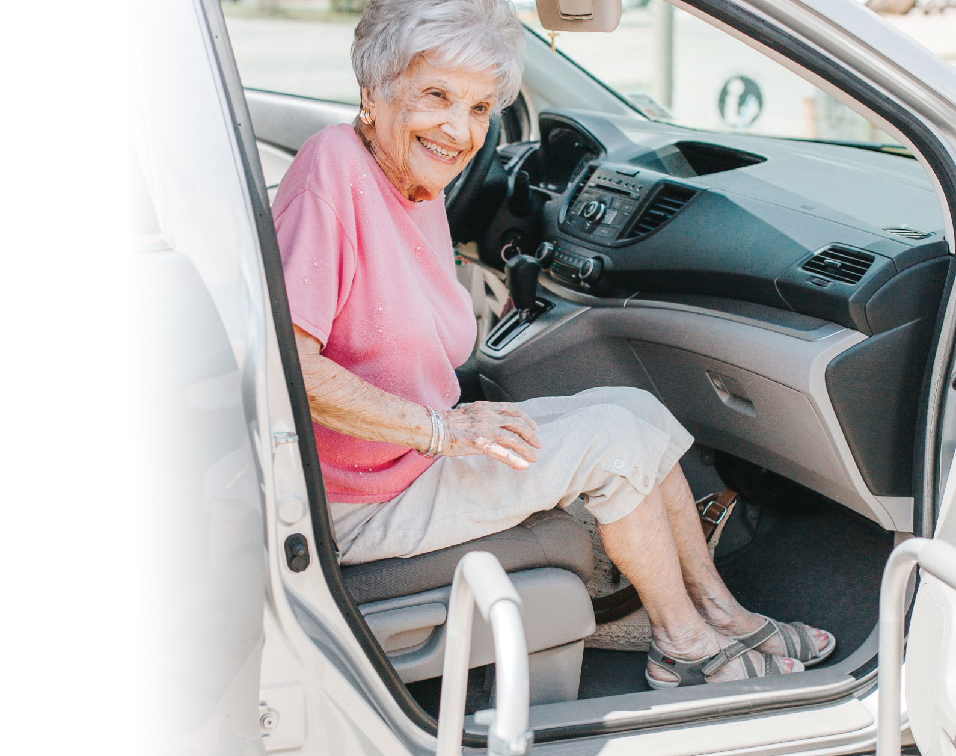
What is Assistive Technology?
The umbrella term given to products and systems that allow individuals to perform tasks that might otherwise be difficult or impossible

Slide 4
Why is Assistive Technology important?
Our population is ageing, AT is a key factor in healthy ageing
Maintains or improves individuals' function and independence, promoting wellbeing
Increases the ease with which tasks can be performed
Increases safety of tasks that can be performed
Increases community access
Reduces need for formal and ongoing care
Enables individuals to live at home and prevent need for residential care

Slide 5
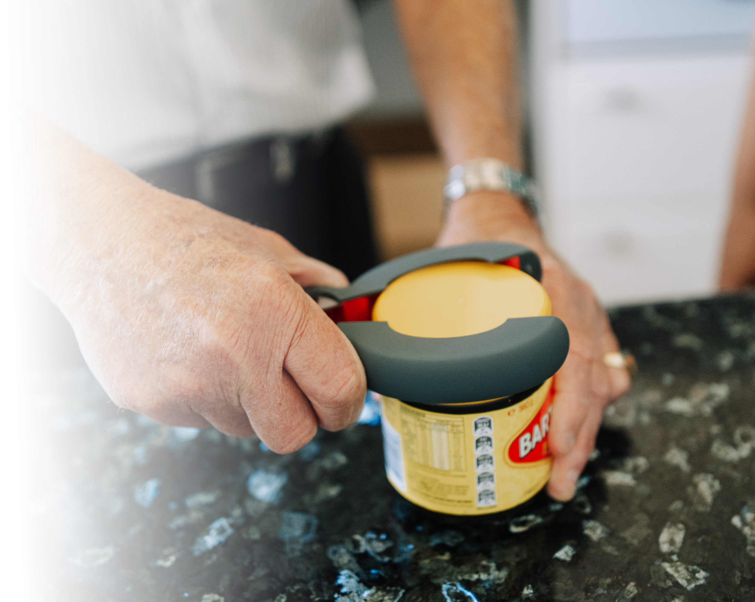
What is low risk Assistive Technology?
Simple aids that support a reablement approach
Modified eating utensils, long handled personal care and cleaning products
Unlikely to result in failure, harm or injury
Can be purchased by the general public

Slide 6
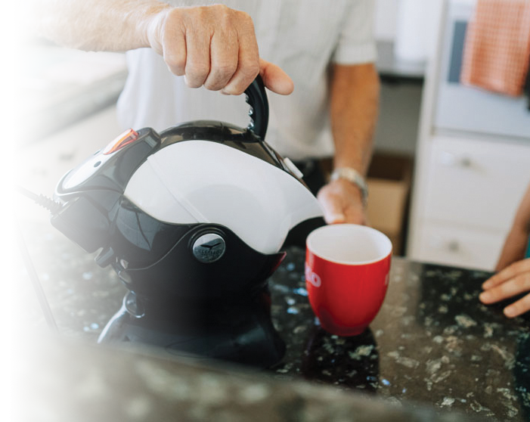
When should Assistive Technology be used?
Help clients achieve their individual goals
When learning or re-learning skills have not been successful
To find ways around a difficulty
To reduce reliance on another person
An Allied Health Professional has recommended it

Slide 7
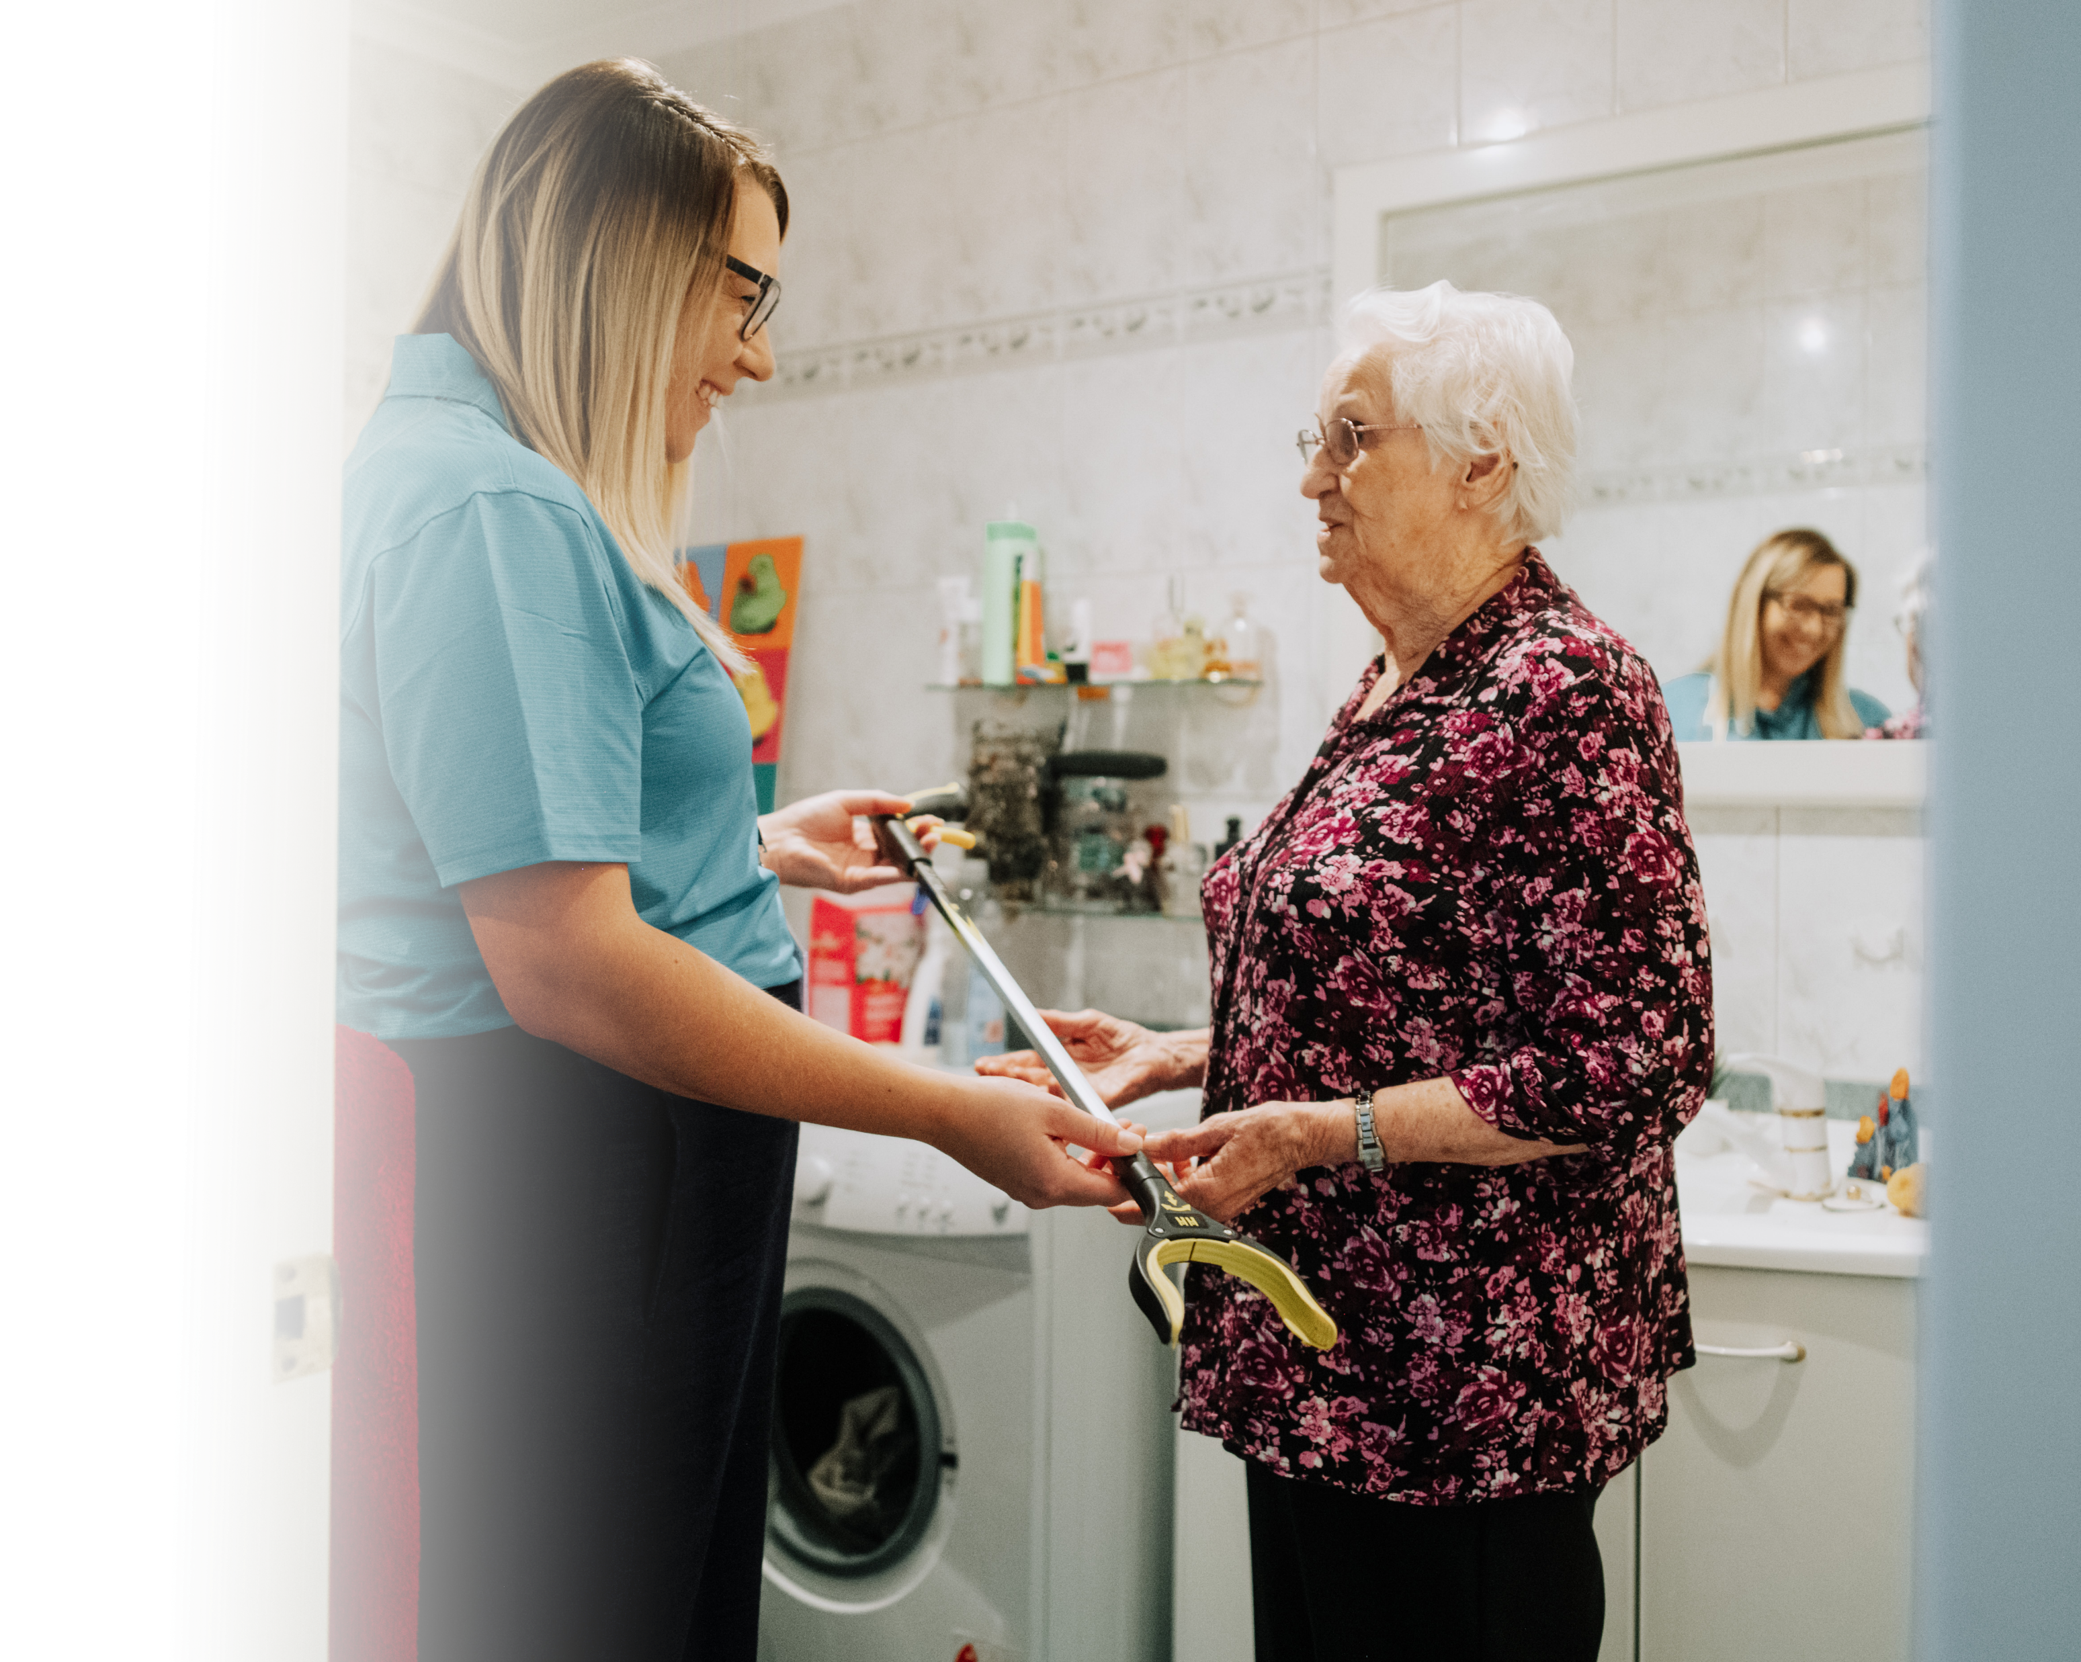
How should Assistive Technology be used?
Assessors and Home Care Providers can actively facilitate the use of low risk AT
Breaking down tasks and identifying difficult
Recommending strategies and AT
Demonstrating use of AT
Building confidence

Slide 8
Putting Learning into Practice 1
An activity to raise awareness of low risk assistive technology readily available:
Look at the photographs of some commonly used low risk assistive technology and name the items
List a few possible reasons why you might recommend these assistive technologies to your clients
Consider previous clients you have referred for ongoing services or delivered ongoing support to who may have been able to return to their previous level of independence if they were confident and competent in using the appropriate assistive technology
Share your thoughts with the group

Slide 9
Putting Learning into Practice 2
An activity to increase confidence in recommending and demonstrating assistive technology:
In pairs, practice using the sock aid to put on your socks
Follow the instructions on the hand-out if you are not familiar with how to use one
As your partner practices using the sock aid, consider how you might assist a client to use one without offering physical support
Feedback to rest of group - how did you support your client/partner to use the sock aid? Do you feel confident supporting a client to use a sock aid?

Slide 10
When should I refer to an Allied Health Professional?
Client is a falls risk
Recent and rapid change in function
AT product needs to be measured or fitted
Client unlikely to manage task even with AT
Modifications to the environment are required for safety
AT Product has potential to cause harm
Client has AT in the home but is not utilising
Client appears to require numerous AT products

Slide 11
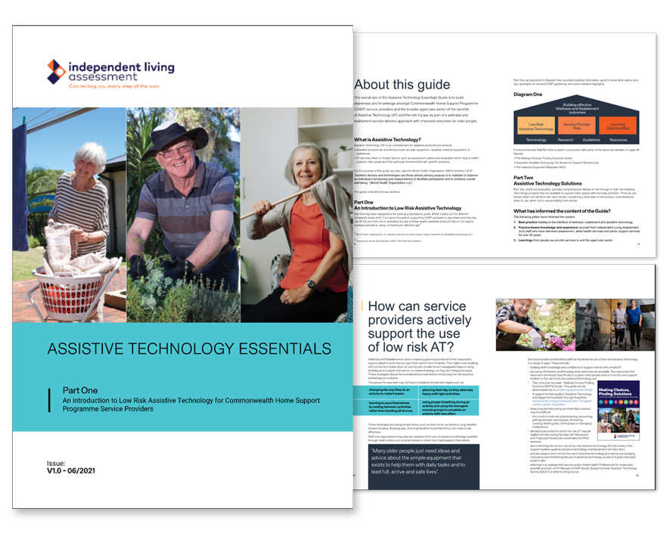
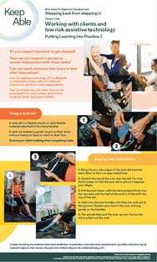
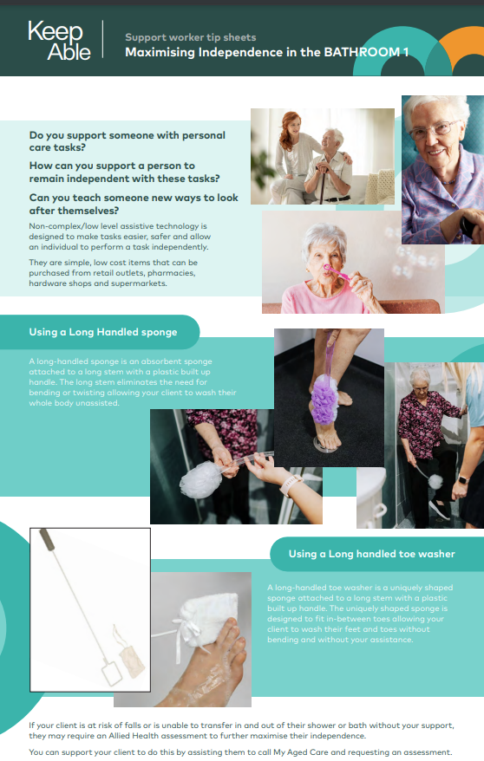
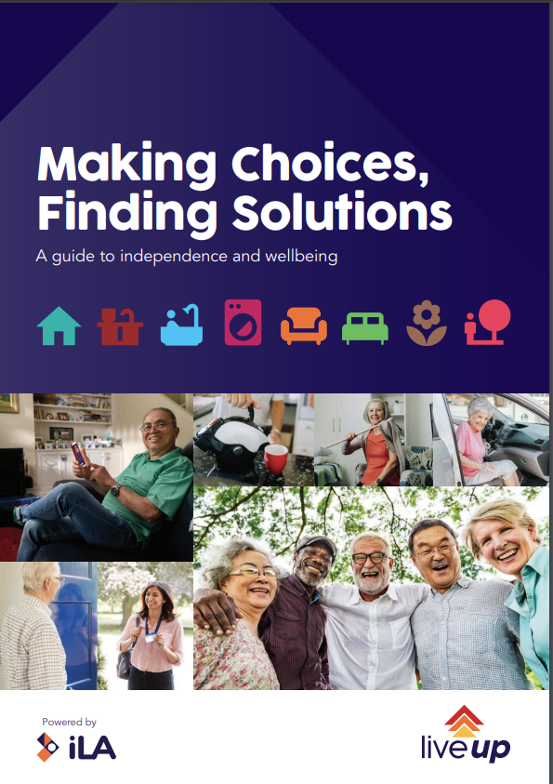
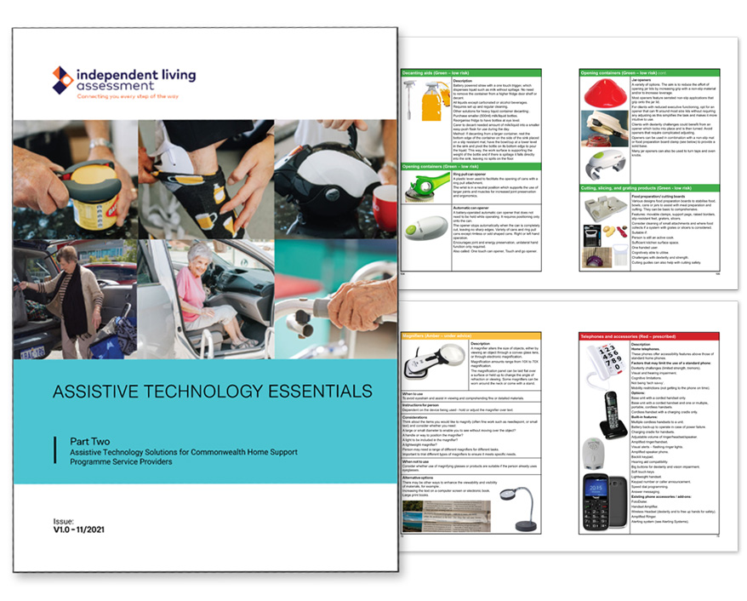
Where to next?
KeepAble (keepable.com.au)
- Support Worker Factsheets
- Essentials of AT Guides
Making Choices, Finding Solutions (https://www.ilaustralia.org.au/)
CHSP Goods Equipment and Assistive Technology (geat2go.org.au)
LiveUp (liveup.org.au)

Slide 12
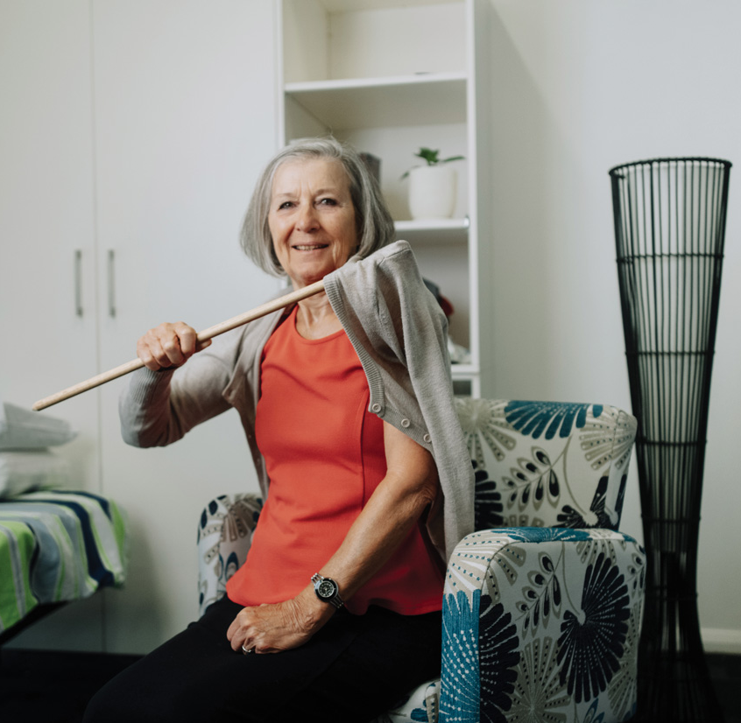
Any questions?
Evaluation
Thank you

