Slide 1
Introducing LifeCurve™
A new perspective on the reablement discussion
Bitesize Skills Development
‘Stepping back from stepping in’
Notes:
Welcome
Introductions (if required)
Acknowledgement of Country
‘We pay our respect to Aboriginal and Torres Strait Islander cultures, to Elders past, present and emerging, and to all Aboriginal and Torres Strait Islander peoples including members of the Stolen Generation.’
(or substitute with your organisation’s local profile of Country and Nation)
About the session
‘This Bitesize session shares important knowledge about the impact of normal ageing on a person’s functional abilities. Learning about LifeCurve™ will give you, your clients, and their support networks an excellent foundation for understanding wellness and reablement.’
Time
1 minute (+ introductions)

Slide 2
Participants will:
Identify
and understand the key elements of LifeCurve™
Session objectives
Use
the LifeCurve™ to identify two common patterns of age-related functional decline
Recognise
that older adults can have ‘more good days’ with positive lifestyle choices and timely help
Understand
the value of LifeCurve™ in promoting reablement to aged care teams & consumers
Notes:
Presenter
[Read out slide contents]
‘Before we start discussing LifeCurve™, it’s important to acknowledge that there can be barriers to implementing wellness and reablement approaches. We’re going to explore some of these first and then consider how LifeCurve™ can help to overcome those barriers.’
Time
1 minute

Slide 3
Implementing reablement:
Client challenges
Your client says:
Your client just wants:
‘I’m too old for that’
A cleaner and gardener
‘I’ve done enough cleaning in my lifetime’
Someone to cook their meals for them
Someone to do the shopping and put it all away
‘I’m too tired to do all that’
‘I’m not strong enough’
(while they relax!)
Notes:
Slide 3 - Implementing reablement: Client challenges
Presenter
‘There are many challenges to implementing wellness and reablement. One of the most reported difficulties is client resistance.’
Click
‘Have you ever heard one of your clients say any of these things?’
[Read out points on slide and invite comments]
Click
‘Do you think your clients and often their support networks just want the following services?’
[Read out points on slide and invite comments]
‘These attitudes make implementing wellness and reablement extremely difficult. So, how can we make older adults want wellness and reablement? We need to find a way to change the conversation and LifeCurve™ can help.’
Time
2 minutes

Slide 4
Implementing reablement:
Summary
Industry/provider challenges
2023 CHSP Wellness and reablement report outcomes
Clients ‘resisting reablement approaches due to fear, skepticism, or a sense of dependency…’ (p. 46)
Consumer mindset – the expectation that the provider will ‘do for’ instead of ‘do with’ the client
Difficulty identifying reablement opportunities
Difficulty accessing specific service types (e.g., allied health services)
Need for better staff training about wellness and reablement and supporting tools
Notes:
Presenter
‘Most providers know they need to do wellness and reablement, but they often struggle with how to do wellness and reablement.’
Click
‘This has been revealed in the most recent Wellness and Reablement Outcomes Report.’
Click
‘Here are some key difficulties that were reported by service providers
[Read out points shown on slide]
‘LifeCurve™ is an evidence-based framework that can help address these challenges. It can show staff and clients how the ageing journey can be positively influenced through daily activities and wellness and reablement approaches.’
Time
2 minutes

Slide 5
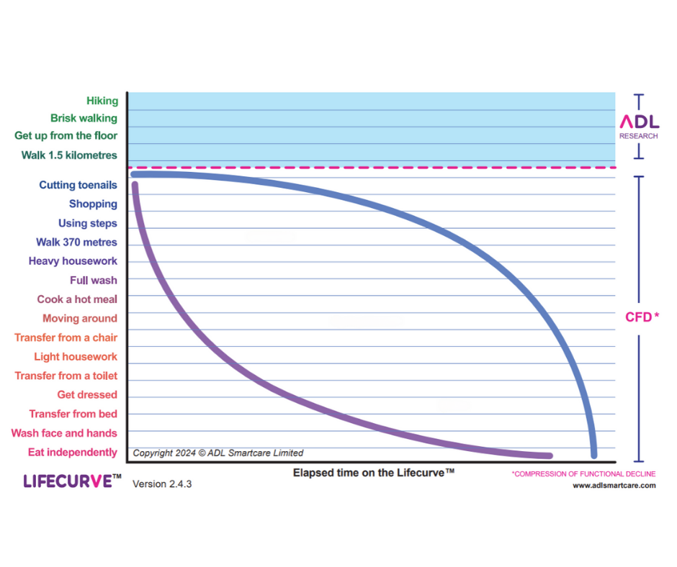
Introducing LifeCurve™
Notes:
Presenter
‘This is the LifeCurve™. It was developed in response to findings by Newcastle University (UK) research team, led by Professor Peter Gore. They studied older adults all over the world to find out how functional abilities are affected by the normal ageing process.
The team discovered there are two common patterns of functional decline that are experienced as people age. One is much more desirable than the other! We’ll discuss that soon.
The research also showed that loss of functional abilities could be delayed or slowed down by good lifestyle choices and the right support. It is possible to compress most of the decline into to a short period of time, very late in life. This is called the ‘compression of functional decline’.
In today’s session, we will learn more about the LifeCurve™ and the different elements you see in the diagram.’
Time
2 minutes

Slide 6
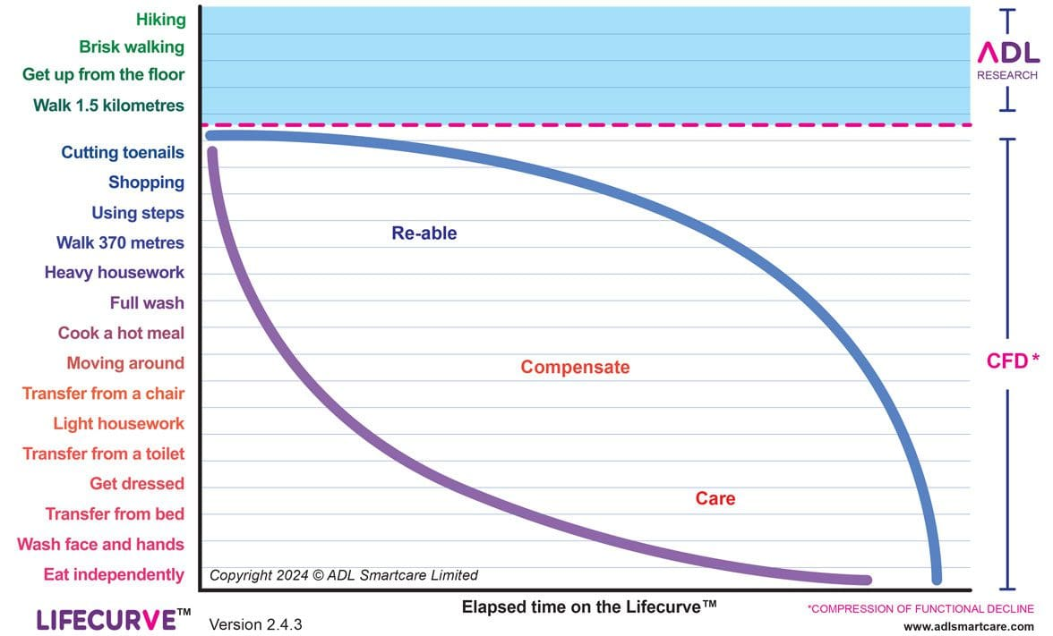
Components of LifeCurve™
The vertical axis
The horizontal axis
The red dotted line
The curves
Intervention types
Notes:
Presenter
‘These are the 5 components of LifeCurve™ that we will explore today.’
[Read out dot points on slide]
Time
30 seconds

Slide 7
The vertical axis
This axis features:
4 fitness-related activities at the top
15 Activities of Daily Living (ADL) underneath
Bullet point
Bullet point
Notes:
Presenter
‘Professor Gore’s research team discovered that in the process of normal ageing, functional abilities are lost in a predictable order.
This order is shown on the vertical exis of the LifeCurve™. The most challenging activities are at the top and the least challenging are at the bottom.’
Click
‘At the very top, there are 4 activities in green. These activities are indicators of fitness.’
Click
‘Below are another 15 activities. They are all activities that help us participate in daily living at home and in the community and look after our bodies.
An example of what the hierarchy can tell us is, an older person will lose the ability to get up from the floor before losing the ability to cook a hot meal.
Remember, LifeCurve™ is based on data collected from all over the world. This means the pattern of functional decline is common to diverse populations.’
Time
1 minute

Slide 8
The horizontal axis
The horizontal axis represents time elapsed.
Notes:
Presenter
‘The horizontal axis represents time passing as you look from left to right. You can see the axis does not specify age in years. This is because individuals experience functional decline at different ages and rates. LifeCurve™ shows patterns of functional decline, not the ages at which decline is expected.
This is also an important concept as we challenge ageism in society. We should never make assumptions about what a person can or cannot do, based on their age.’
Time
1 minute

Slide 9
The red dotted line
The red dotted line represents the point where a person is commencing concerning functional decline.
Notes:
Presenter
‘The red dotted line represents the point where concerning age-related functional decline starts. You can see that the first functional indicator of concerning decline is the inability to cut toenails.
This is something that can be easily overlooked or disregarded. Often the person is simply referred to a podiatrist. However, it is an important warning sign.
When it is recognised, it becomes an opportunity to take positive action. Ideally, the person’s functional ability would be improved.
However, even if they don’t improve, the right action can help prevent, or significantly slow down functional decline at this stage.’
Time
1 minute

Slide 10
The curves
The two curves (blue and purple) represent possible trajectories of functional losses.
The purple curve represents an early and rapid functional decline
The blue curve represents a delayed and slow functional decline
Bullet point
Notes:
Presenter
‘Some functional decline may be expected with advancing age. However, the extent and rate of decline is different between individuals.
Professor Gore’s research team identified two common patterns of age-related decline. One is much more desirable than the other!
Looking at the purple curve, you can see it shows an early and steep decline in functional abilities. A person on this path would “slide down” the curve quickly. They are less likely to participate in activities around the home and in the community. They will be more dependent upon others and are at increased risk of needing residential care.
By comparison, the blue curve stays high on the graph for a long time. Most of the decline is compressed into a short time at the very end of life. It represents a person who will have more ‘good days’ or a longer ‘health span’. They are more likely to remain living actively, safely, and independently in their own home and need fewer services.
Being on the blue curve doesn’t necessarily mean living longer, but it does mean living better.’
Time
2 minutes

Slide 11
Choose a curve
If you were an old older adult, what would be your preferred path?
The blue curve?
The purple curve?
Notes:
Activity
Presenter: ‘Think about which path you would prefer, if you could choose.”
Note to presenter:
If presenting in person, encourage a show of hands for blue versus purple.
If presenting online, encourage responses with emoticons, such as thumbs up for blue of thumbs down for purple.
Ask your audience for some feedback about why they chose the one they did.
Presenter
[Reiterate the LifeCurve™ evidence, see below]
‘The blue curve would generally be considered the preferred path. This indicates you would have more good days in your later years. You would be more likely to remain in your chosen home and community, doing the things that are important to you.
The purple curve would not be the preferred path for most people. This path represents a rapid decline into dependency. It is often accompanied by chronic health conditions that can cause disability, illness, and fatigue. It is likely you would lose the ability to do the things you love and to live in your preferred home and community.’
Time
3minutes

Slide 12
Interventions
Re-able
Compensate
Care
Notes:
Presenter
‘At the start of the session, we acknowledged that many providers have difficulty knowing when a person is suitable for reablement. LifeCurve™ can help.’
Click
‘The best reablement opportunities are when the person’s functional abilities have just slipped under the red dotted line. Early, goal-directed reablement interventions can help lift them back up the axis to promote their health, independence, and wellbeing. Because CHSP is an entry-level aged care programme, many clients are at this level. Exceptions may include people who are waiting for a home care package.’
Click
‘When people are having difficulty with activities, we can compensate for functional losses. We can provide assistive equipment, like a walking frame, or we can change a task to make it easier. This is helpful for people at the approximate level indicated on the graph. Reablement interventions can still be offered in addition to compensatory approaches. However, when a person’s abilities have slipped down to the middle of the axis, it is harder to climb to the top again. At this level, the ideal window for reablement interventions has been missed.
Click
‘People at this level need care from others for basic personal care tasks. They are often in poor physical condition. It is still important to look for remaining skills or abilities. Encourage people to “use it or lose it” and improve where possible. Continuing to support their remaining abilities can make the difference between living at home with support or needing residential care.’
Time
2 minutes

Slide 13
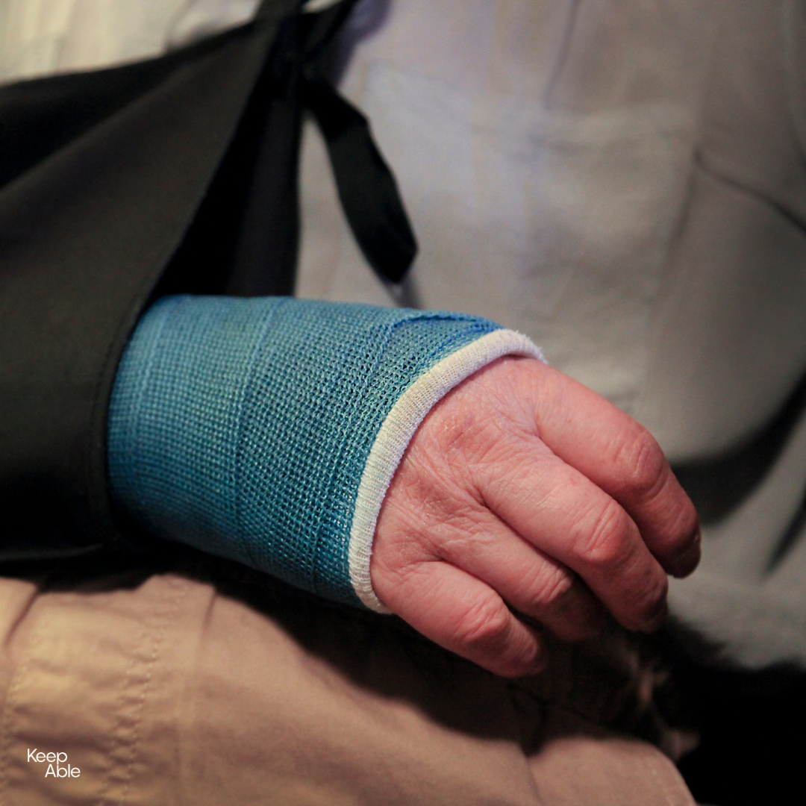
Interventions
“My client broke her arm and is in a cast. Now she can’t eat on her own. If she is at the bottom of the LifeCurve, does this mean she isn’t suitable for reablement?”
Notes:
Presenter
[Read out the question]
Time
30 seconds

Slide 14
Interventions
Good question!
These are examples of incidents that are not part of the normal ageing process:
Sickness (e.g., pneumonia)
Fractures
Elective surgery (e.g., hip replacement)
Stroke
Conditions such as Parkinson’s Disease and Dementia are also not part of the ‘normal’ ageing process.
Notes:
Presenter
Click
‘Before we think about the lady with the broken arm, reflect on what LifeCurve™ shows us. LifeCurve™ helps identify people experiencing age-related functional decline over the course of months and years.
LifeCurve™ does not represent the functional change of the lady with the broken arm. She had an incident that caused an immediate and dramatic drop in function, rather than a progressive decline. However, she is definitely a candidate for reablement.
LifeCurve™ is still relevant when we consider her previous level of function. If this lady was doing activities above the red line, then she was fit, active and independent. She would be likely to make a full recovery.
However, if she was previously in the “Compensate” or” Care zone”, her potential to recover functional abilities will be much less.
It is a good example of why it is important to maintain abilities as we age. It makes us much more resilient when incidents occur.
Here are some examples of common incidents that are not part of “normal” age-related decline.’
Click
[Read out points on slide]
Click
[Read out the revealed content]
‘Most people experiencing these incidents or conditions will benefit from rehabilitation or reablement. However, their pattern of functional losses and gains will look different to what is shown on the LifeCurve™’
Time: 3 minutes

Slide 15
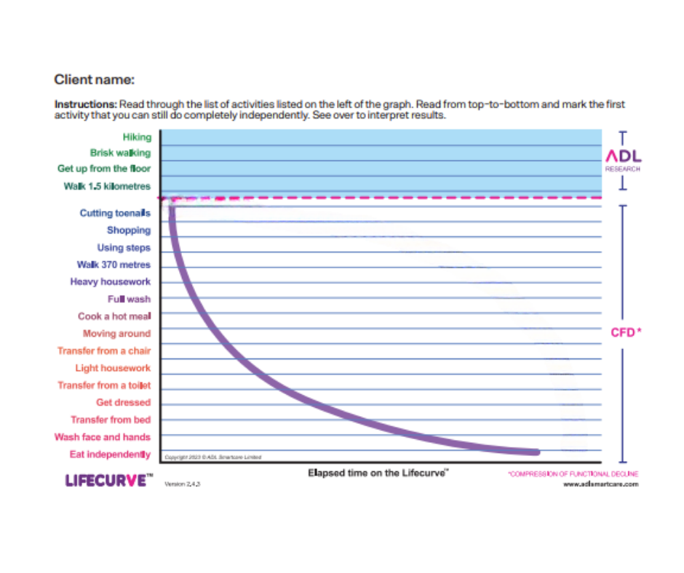
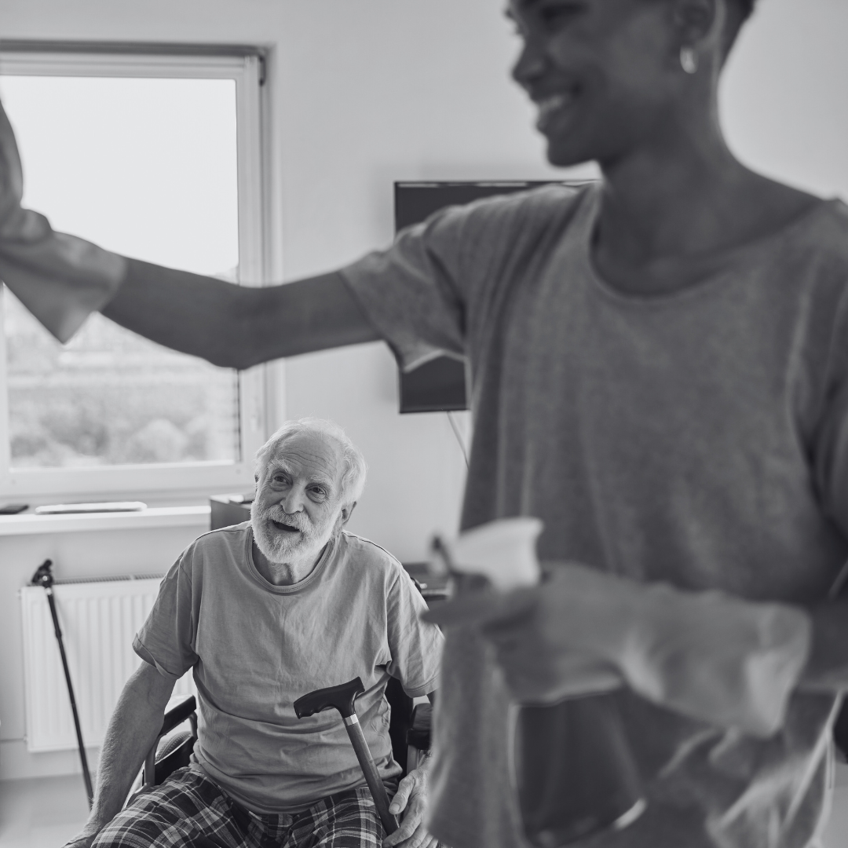
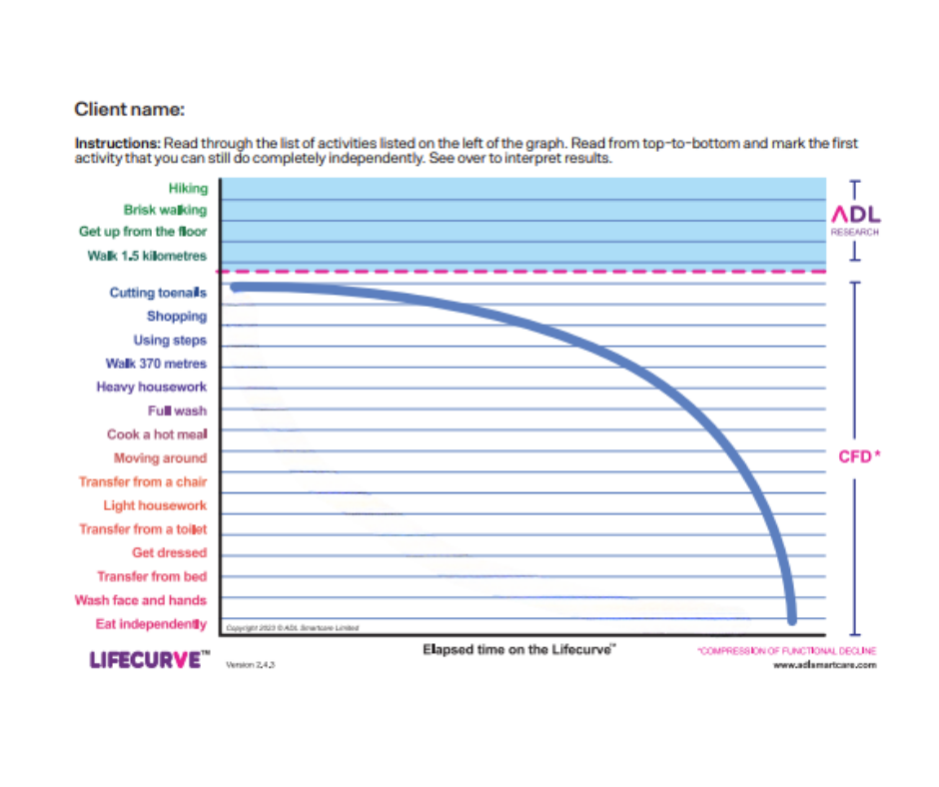
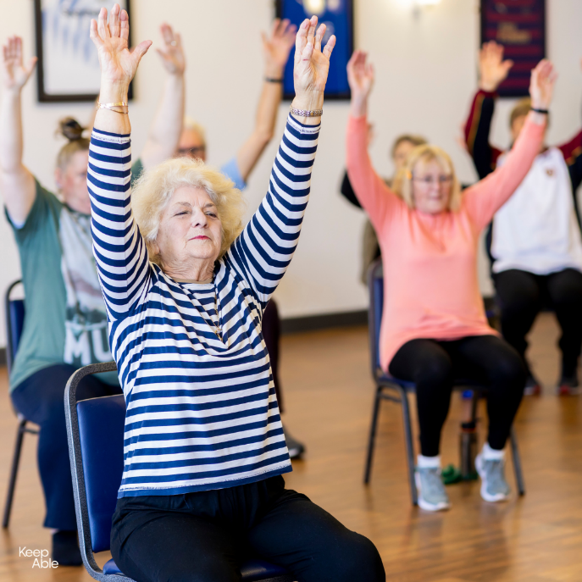
Taking control of the ageing journey
Research shows that 70% of our ageing journey is related to factors other than genetics, such as lifestyle.
Notes:
Presenter
‘Earlier we asked which ageing path you would choose if you could. As it turns out, we have a lot of control over that situation.’
Click
‘Many of us, and many of our clients, believe their ageing path is already set for them because of their genetic make up. The research tells us that 70% of our ageing journey is related to factors other than genetics, such as lifestyle.’
Click
‘The research reveals that when we stop doing a variety of activities around the home, in the community, and with our family and friends, our functional abilities decline. Quickly. Giving up activities that we can do ourselves sets us on a “purple path”. This is what happens when a client gets cleaning services even if they can do the tasks on their own.’
Click
‘The opposite is also true. When we stay actively engaged in a variety of activities at home and in the community, it increases our chance of taking the more desirable blue path in later years.’
Time
2 minutes

Slide 16
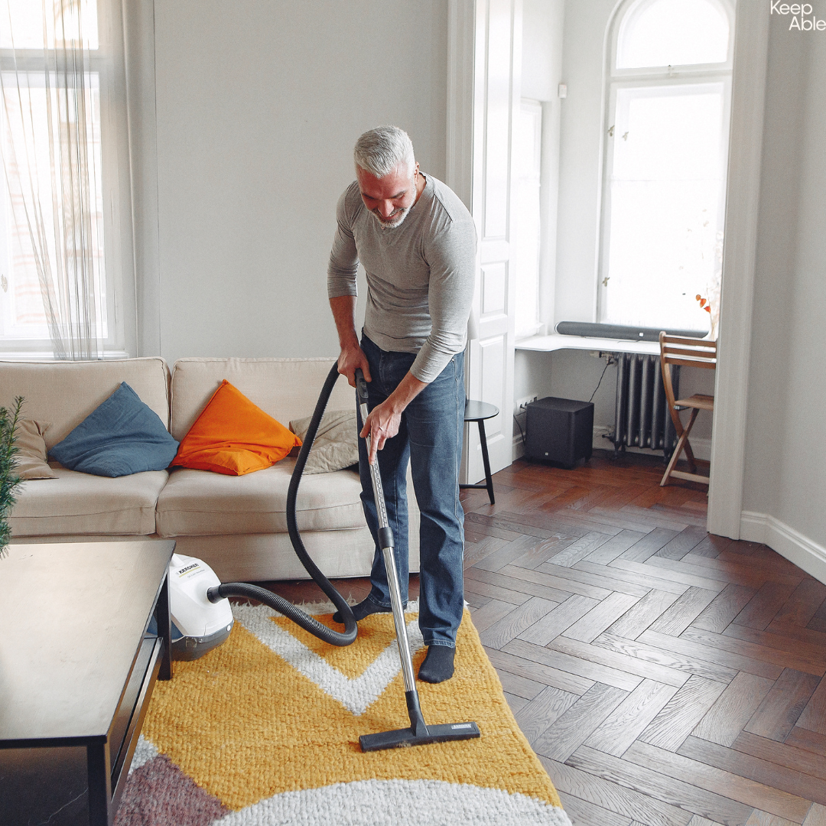
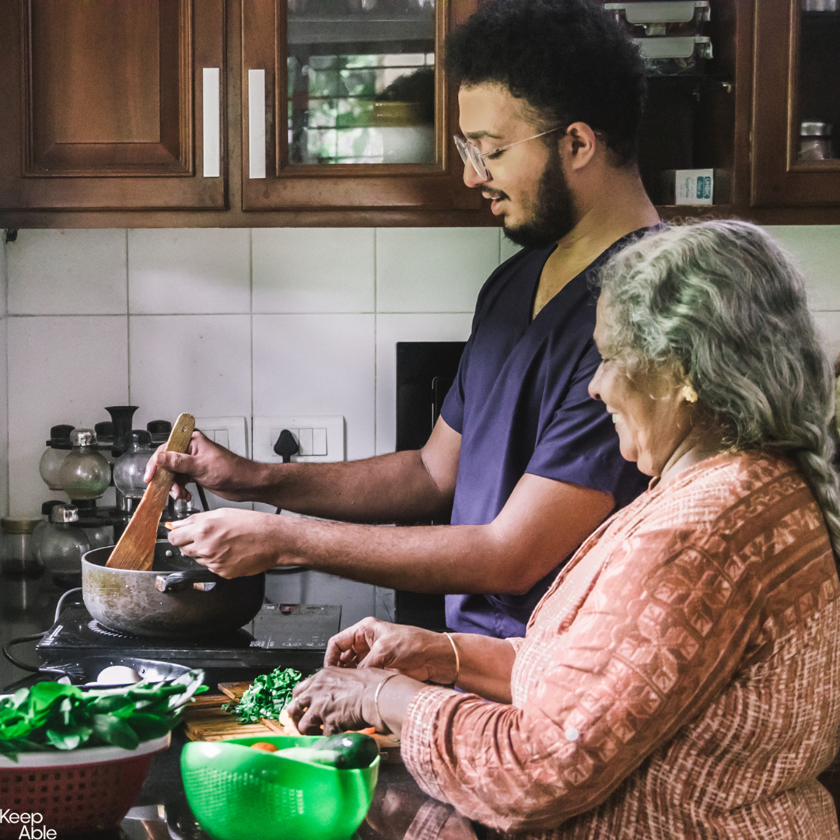
Staying active supports…
Staying active supports…
Physical health
Brain health
Mental health
Premature help = Premature disability!
Notes:
Presenter
‘Staying active sets us on the blue curve path because daily activities support...’
Click
‘Physical health, including balance, strength, and fitness.’
Click
‘Brain health and cognitive skills, such as concentrating, problem solving, memory, planning, and organising.’
Click
‘Mental health, such as having a sense of purpose and feeling connected with others.
We should try and discourage older people from accepting services they don’t need. This is because…’
Click
‘Premature help results in premature disability.’
Time
1 minute

Slide 17
How LifeCurve™ can help clients
LifeCurve™ can help share ageing science with older adults.
LifeCurve™ can help older people:
Think realistically about their current ageing journey
Understand the potential ageing paths
Make informed lifestyle choices to best support their ageing journey
Recognise that wellness and reablement can improve the ageing journey
Be inspired to set goals for improved functional ability and quality of life
Notes:
Presenter
‘When we make decisions about anything in life, we want to do it based on good information.’
Click
[Read out the introductory sentence]
‘When you were asked to choose between the blue and purple journey, was it the evidence that led you to your choice? If the blue curve journey is what you want, then older people probably want it too. We just need to tell them about it! The research revealed that LifeCurve™ is easily understood by older people and their support networks, so why not share it?’
Click
[Read out the next sentence]
Click
[Read the first point and continue clicking through until all 5 points are revealed]
Time
1 minute

Slide 18
How LifeCurve™ can help service providers
LifeCurve™ can help service providers:
Identify clients who are suitable for reablement and/or other approaches
Motivate clients to participate in reablement
Uphold aged care quality standards by:
Promoting clients’ informed decision making, based on evidence
Supporting independence
Promoting collaborative assessment and care planning
Enhancing staff knowledge to support evidence-based practice
Notes:
Presenter
‘We began by identifying some of the difficulties that service providers have with implementing reablement. Here are some of the ways LifeCurve™ can address those issues.’
Click
[Read out introductory sentence]
Click
[Read out the first point and continue clicking through until all 3 points are revealed]
‘Does anyone see opportunities to use LifeCurve™ to promote wellness and reablement in their team or with clients and client support networks?’
Time
1 minute

Slide 19
Learning activity
Now we will:
Compare the experiences of Imelda and Tom who have both recently experienced functional decline
Break into groups of 2-3 and discuss one of the case studies (8 minutes)
Compare the experiences of Imelda and Tom, and see how LifeCurve™ influences our understanding of these clients’ journeys (5 minutes)
title
Notes:
Presenter
Options for learning activity:
If presenting face to face: Provide participants with a work sheet. Each group is to do 1 case study only.
If presenting online: Send your participants to online break out rooms. Ensure you allocate them 1 case study. Worksheets should have been emailed to participants prior to the session.
If you don’t have time... The learning activity can be done as a second session.
The learning activity could be incorporated into a staff meeting at a future date.
Time
8 minutes for groups to work on case studies.
5 minutes to share ideas together. See supporting document for sample answers and discussion points.

Slide 20
Summary (Part 1/2)
LifeCurve™…
Is an evidence-based framework that shows patterns of normal aged-related decline
Shows functional decline is delayed or slowed when people remain active at home & in the community
Can help motivate clients by sharing positive ageing science
Can help identify candidates for reablement
Notes:
Presenter
[Read out slide content]
Time
30 seconds

Slide 21
Summary (Part 2/2)
Compressing (delaying or slowing) functional decline…
Promotes wellbeing by supporting independence and dignity
Helps older people have ‘more good days’
Supports older people to remain in their home and community of choice
Notes:
Presenter
[Read out slide content]
Time
30 seconds

Slide 22
Thank you
Questions?
Notes:
Presenter
Thank everyone for attending
Encourage attendees to complete a feedback form
Don’t forget to update your staff training logs!
Time
1 minute + completion of feedback form

