Slide 1


What and why of wellness and reablement
Bitesize Skills Development
‘Stepping back from stepping in’

Slide 2


Participants will:
Define
wellness and reablement
Session objectives
Understand
why wellness and reablement is embedded
in all aged care services
Understand
how wellness and reablement approaches differ from traditional home care services
Reflect
upon their own practices when working with older adults

Slide 3


What does wellness and reablement mean?
This question has been the source of much confusion.
Why?

Slide 4



First...What is wellbeing?
“How you feel about yourself and your life”
betterhealth.gov.au
Physically
Mentally
Cognitively
Socially

Slide 5
A happy intimate relationship with a partner
Living in a fair and democratic society
A sense of belonging
Enough money
Having a fulfilling career
Fun hobbies and leisure pursuits
The ability to adapt to change
Realistic and achievable goals
Factors that
influence wellbeing
Healthy self-esteem
Regular exercise
Optimistic outlook
Nutritious diet
Enough sleep
Spiritual or religious beliefs
A network of close friends
Sense of purpose and meaning

Slide 6
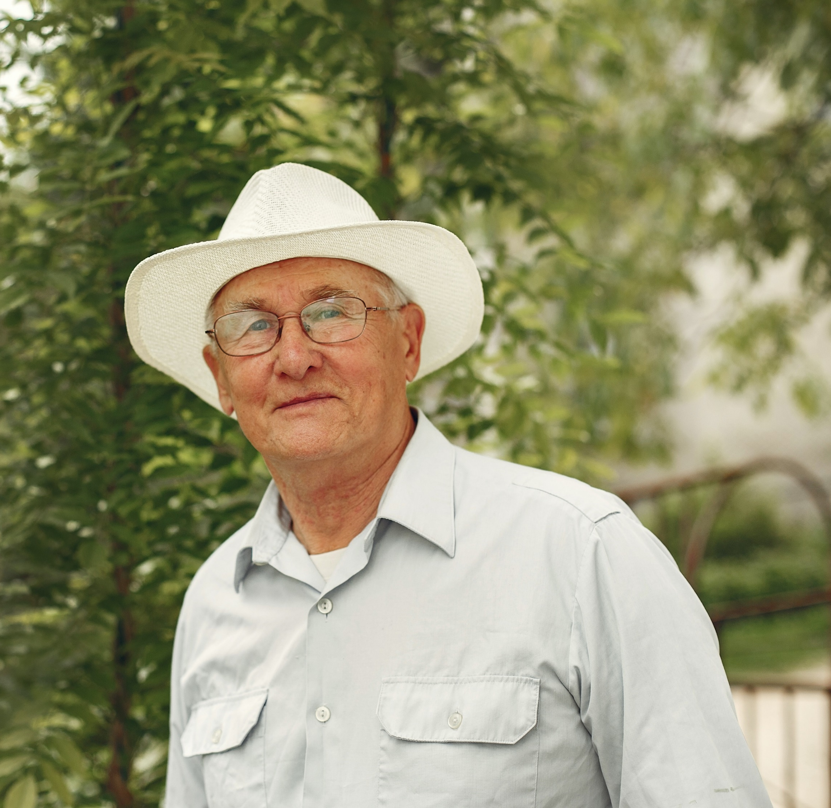
What is a ‘wellness’ approach?
“…assessment, planning and delivery of support that builds on individuals' strengths, capacity, and goals and encourages actions that promote independence in daily living tasks, as well as reducing risks to living safely at home”. ​
Living well at home: CHSP Good Practice Guide
Department of Health and Aged Care (2015)

Slide 7
OK, what is ‘reablement’ then?
“…short-term or time-limited interventions that target a person's specific goal or desired outcome to adapt to some functional loss or regain confidence and capacity to resume activities”.
Living well at home: CHSP Good Practice Guide​
Department of Health and Aged Care (2015)
Independence
Achievement
Participation
Reablement
Improved wellbeing

Slide 8

Wellness and reablement. Same but different.
Principles
Wellness
Reablement
Encourages independence
Builds on strengths and abilities
Avoids “doing for” and encourages “doing with”
Focuses on what the person can do and potentially do
Focuses on what the person can do and potentially do
Identifies and addresses what the person wants to do
Identifies and addresses what the person wants to do
Aims to minimize the need for services
Aims to minimize the need for services
x
No time limitation
No time limitation
x
Time limited (up to 12 weeks)
Time limited (up to 12 weeks)
x
Interventions generally more intensive
Interventions generally more intensive

Slide 9
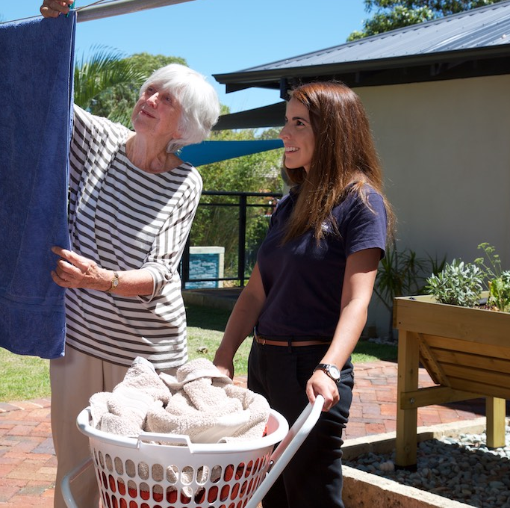
5 ways to improve independence:
Building capacity
(e.g. improve balance)​
Modifying the environment​
(e.g. installing grab rails)​
Modifying tasks​
(e.g. sitting down to prepare vegetables)​
Providing assistive technology ​
(e.g. jar opener)​
Providing helpful information​
(e.g. falls prevention)​

Slide 10

Times are changing​
In the past… ​
Home Care services = Doing for clients
​​
Now…
Home Support services = Doing with clients

Slide 11

Why wellness and reablement?
Budget and Human Resources pressures
Royal Commission into Aged Care recommendations
It works!
It’s respectful
And most importantly…

Slide 12
It supports the Human Rights of older adults
Older persons should have access to health care to help them to maintain or regain the optimum level of physical, mental and emotional well-being and to prevent or delay the onset of illness”
(United Nations Principles for Older Persons)

Slide 13
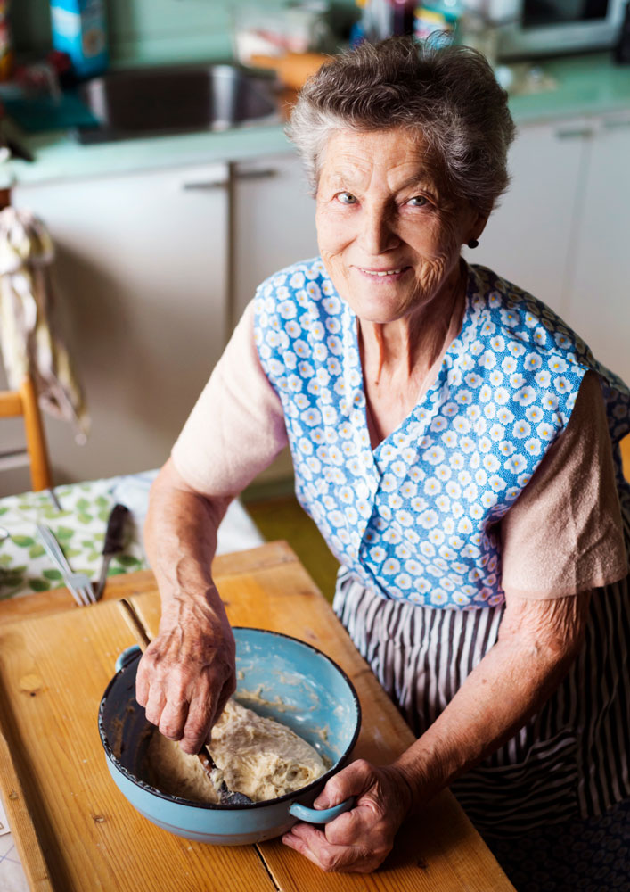
Achieving excellence in wellness and reablement…​
…may require you to re-think ageing ​
and how you work with older people.

Slide 14
Do you work in aged care because you…
Want older people to maintain and/or improve their skills and abilities?
Feel sorry for older people?
Want to work in partnership with older people so they can do the things that are important to them?
Want to “look after” older people?
OR
Want to keep older people safe?
Want to support older people to be independent?
Want to make their lives easier because it is difficult being old?
Partner with older adults so they lead fulfilling lives as valued members of the community?

Slide 15
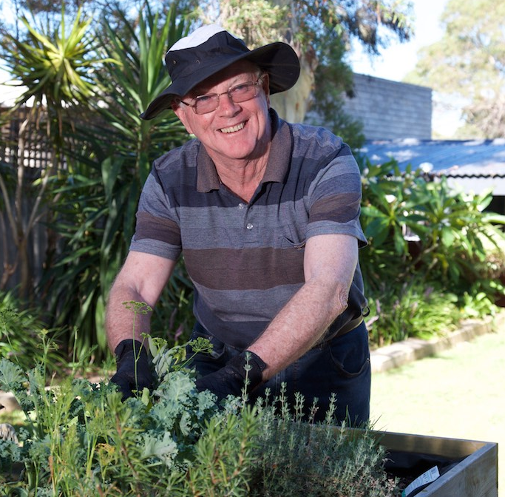
Thoughts can influence outcomes
The success of wellness and reablement depends upon employees and society recognising the knowledge, skills, abilities and potential of older people.

Slide 16

Re-think to Re-able
Ask yourself, ”Am I supporting the older person’s human rights to health, wellbeing and independence?”​
75% of a person’s ageing experience is influenced by lifestyle factors, not genetics.​
It’s never too early and almost never too late to make ​lifestyle changes. ​
Help clients be physically active at home and in the community. Movement is medicine!​
Encourage older people to try new things.​

Slide 17



Learning activity
Identifying strengths
Think of a client or older person that you know.
Use the worksheet provided to identify their strengths (rather than focusing on their problems).
Discussion
Share at least one of your observations with
the group.
Group discusses how this strength can support
a person’s wellbeing and participation in life.

Slide 18

Summary
Wellness and reablement approaches are required at all levels of aged care services because they support healthy ageing.
Wellness is an overall approach that supports older adults to have meaningful, fulfilling lives and promotes independence.
Reablement services are more intensive, time limited
and goal-focused.
Healthy ageing is achieved by participating in all aspects of household, family and community life.
Healthy ageing is a human right and you can support it!

Slide 19


Thank you
Questions?

